Slide 1
Multiple Regression
Analysis: Further Issues

Slide 2
Multiple Regression
Analysis: Further Issues
More on Functional Form
More on using logarithmic functional forms
  Convenient percentage/elasticity interpretation
  Slope coefficients of logged variables are invariant to rescalings
  Taking logs often eliminates/mitigates problems with outliers
  Taking logs often helps to secure normality and homoskedasticity
  Variables measured in units such as years should not be logged
  Variables measured in percentage points should also not be logged
  Logs must not be used if variables take on zero or negative values
  It is hard to reverse the log-operation when constructing predictions

Slide 3
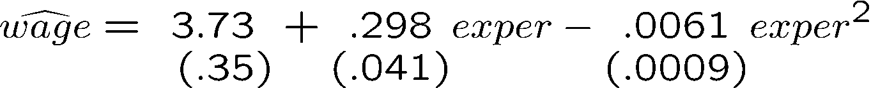


Multiple Regression
Analysis: Further Issues
Using quadratic functional forms
Example: Wage equation
Marginal effect of experience
Concave experience profile
The first year of experience increases the wage by some $.30, the second year by .298 - 2(.0061)(1) = $.29 etc.

Slide 4
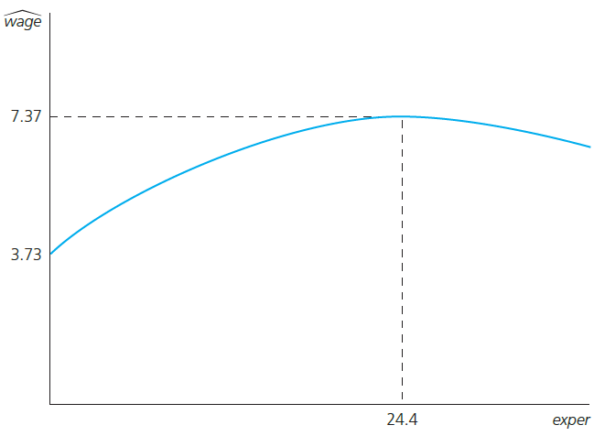
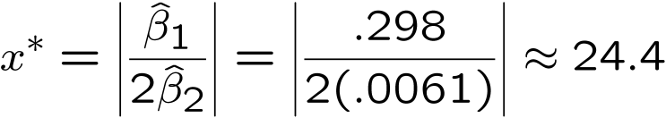
Multiple Regression
Analysis: Further Issues
Wage maximum with respect to work experience
Does this mean the return to experience becomes negative after 24.4 years?
Not necessarily. It depends on how many observations in the sample lie right of the
turnaround point.
In the given example, these are about 28% of the observations. There may be a speci-fication problem (e.g. omitted variables).

Slide 5
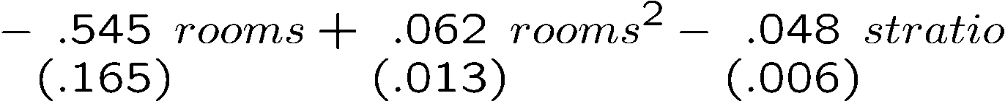


Multiple Regression Analysis: Further Issues
Example: Effects of pollution on housing prices
Nitrogen oxide in the air, distance from employment centers, average student/teacher ratio
Does this mean that, at a low number of rooms, more rooms are associated with lower prices?

Slide 6
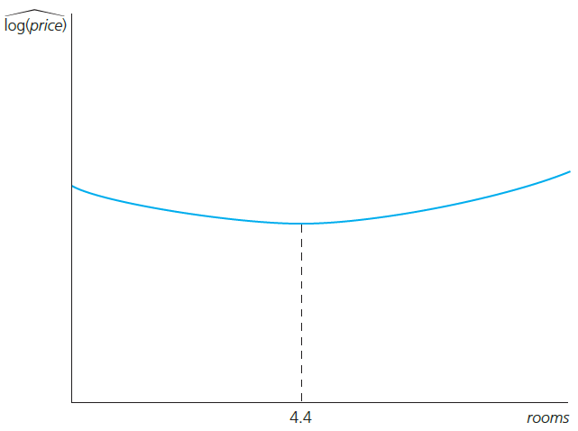
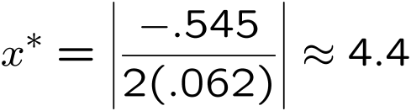
Multiple Regression
Analysis: Further Issues
Calculation of the turnaround point
Turnaround point:
This area can be ignored as it concerns only 1% of the observations.
Increase rooms from 5 to 6:
Increase rooms from 6 to 7:

Slide 7

Multiple Regression
Analysis: Further Issues
Other possibilities
Higher polynomials

Slide 8



Multiple Regression
Analysis: Further Issues
Models with interaction terms
Interaction effects complicate interpretation of parameters
Interaction term
The effect of the number of bedrooms depends on the level of square footage
Effect of number of bedrooms, but for a square footage of zero

Slide 9
Multiple Regression
Analysis: Further Issues
Reparametrization of interaction effects
Advantages of reparametrization
  Easy interpretation of all parameters
  Standard errors for partial effects at the mean values available
  If necessary, interaction may be centered at other interesting values
Population means; may be replaced by sample means
Effect of x₂ if all variables take on their mean values

Slide 10
Multiple Regression
Analysis: Further Issues
Average partial effects
  In models with quadratics, interactions, and other nonlinear functional forms, the partial effect depend on the values of one or more explanatory variables
  Average partial effect (APE) is a summary measure to describe the relationship between dependent variable and each explanatory variable
  After computing the partial effect and plugging in the estimated parameters, average the partial effects for each unit across the sample

Slide 11
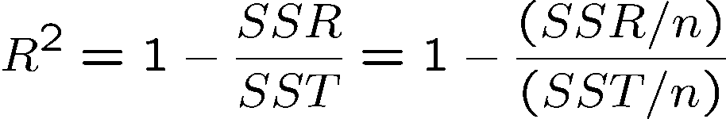
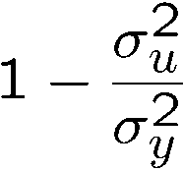
Multiple Regression
Analysis: Further Issues
More on goodness-of-fit and selection of regressors
General remarks on R-squared
  A high R-squared does not imply that there is a causal interpretation
  A low R-squared does not preclude precise estimation of partial effects
Adjusted R-squared
  What is the ordinary R-squared supposed to measure?
is an estimate for
Population R-squared

Slide 12
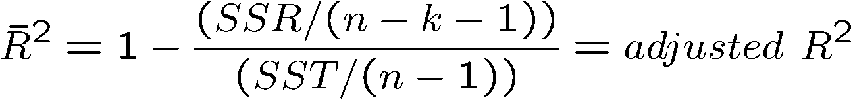
Multiple Regression
Analysis: Further Issues
Correct degrees of freedom of numerator and denominator
Adjusted R-squared (cont.)
  A better estimate taking into account degrees of freedom would be
  The adjusted R-squared imposes a penalty for adding new regressors
  The adjusted R-squared increases if, and only if, the t-statistic of a newly added regressor is greater than one in absolute value
Relationship between R-squared and adjusted R-squared
The adjusted R-squared may even get negative

Slide 13


Multiple Regression
Analysis: Further Issues
Using adjusted R-squared to choose between nonnested models
  Models are nonnested if neither model is a special case of the other
  A comparison between the R-squared of both models would be unfair to the first model because the first model contains fewer parameters
  In the given example, even after adjusting for the difference in degrees of freedom, the quadratic model is preferred

Slide 14

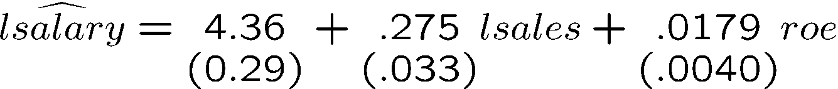
Multiple Regression
Analysis: Further Issues
Comparing models with different dependent variables
  R-squared or adjusted R-squared must not be used to compare models which differ in their definition of the dependent variable
Example: CEO compensation and firm performance
There is much
less variation
in log(salary)
that needs to
be explained
than in salary

Slide 15
Multiple Regression
Analysis: Further Issues
Controlling for too many factors in regression analysis
In some cases, certain variables should not be held fixed
  In a regression of traffic fatalities on state beer taxes (and other factors) one should not directly control for beer consumption
  In a regression of family health expenditures on pesticide usage among farmers one should not control for doctor visits
Different regressions may serve different purposes
  In a regression of house prices on house characteristics, one would only include price assessments if the purpose of the regression is to study their validity; otherwise one would not include them

Slide 16
Multiple Regression
Analysis: Further Issues
Adding regressors to reduce the error variance
  Adding regressors may excarcerbate multicollinearity problems
  On the other hand, adding regressors reduces the error variance
  Variables that are uncorrelated with other regressors should be added because they reduce error variance without increasing multicollinearity
  However, such uncorrelated variables may be hard to find
Example: Individual beer consumption and beer prices
  Including individual characteristics in a regression of beer consumption on beer prices leads to more precise estimates of the price elasticity

Slide 17

Multiple Regression
Analysis: Further Issues
Predicting y when log(y) is the dependent variable
Under the additional assumption that is independent of :
Prediction for y

Slide 18



Multiple Regression
Analysis: Further Issues
Comparing R-squared of a logged and an unlogged specification
These are the R-squareds for the predictions of the unlogged salary variable (although the second regression is originally for logged salaries). Both R-squareds can now be directly compared.

